Slide 1
HMI Training
02 Graphics
Thomas
Godemann

Slide 2
Lecturer(s)
Thomas Godemann
HMI System Designer

Slide 3
Topics
Introduction – Basics
Conti Graphics System (GS4)
Components
Function Overview
Context
Surface
Bitmap Pipelining
Text Pipelining
2D Drawing Pipeline
Resource Management (Types, Groups)
Dependencies
Application Interface (GRLC)

Slide 4
Introduction - Basics
Graphic System Tasks
Interface to the Graphic hardware (GPU)
Interface for Application to
Draw primitives (e.g. dots, lines, polygones…)
Draw bitmaps
Draw textures with meshes
Draw text
Draw complex objects
Manage graphical objects and resources
Support layering, blending and alpha effects

Slide 5
Introduction - Basics
Graphic System Features
Support low to high end Displays
segment, passive dot matrix (LCD)
active dot matrix (e.g. TFT)
Resolutions up to Full HD
Color depth: 1/2/4/8/16 bpp (bits/pixel) or 24/32bpp True Color
Support of 2D/3D graphics
Graphics effects:
Zoom, Motion, Meshing, Anti-aliasing
HW acceleration: Video Out with layers, GPU drawing, Video Input support etc.

Slide 6
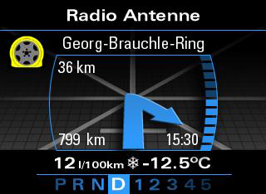
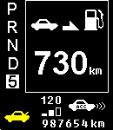
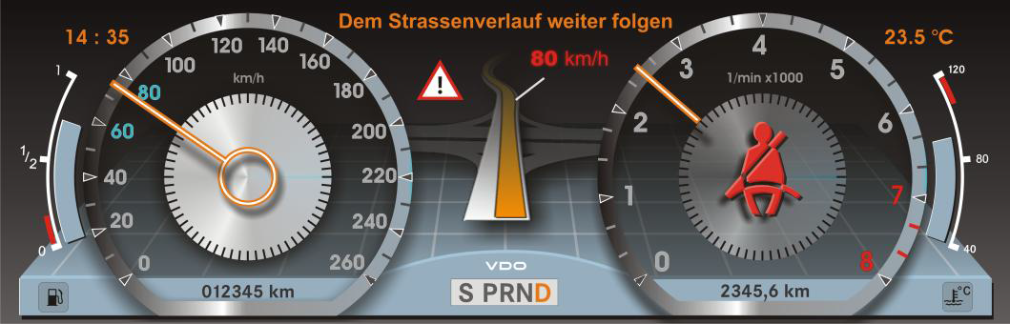
Introduction - Basics
Low
Mid
Scale
ability
High

Slide 7
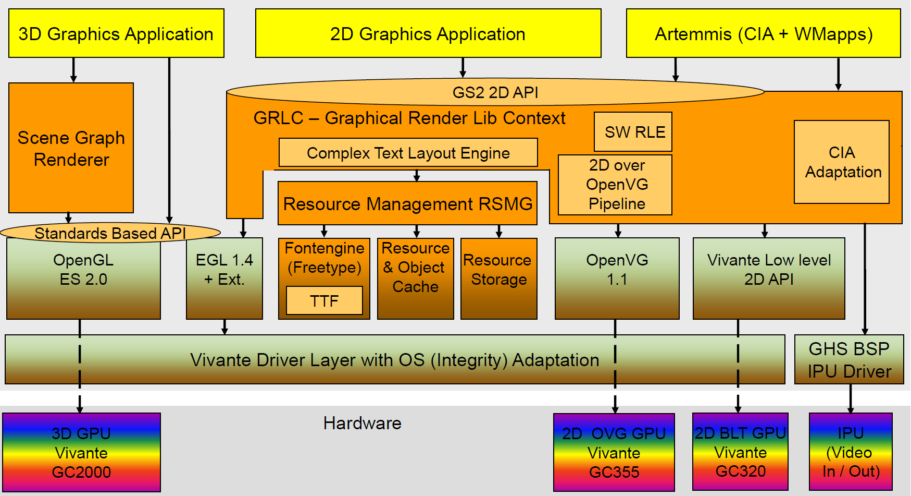
Components
Architecture Overview for JGP2014 system with i.MX6 and Vivante Graphics

Slide 8
Components
Graphic System Packages
GRLC – Application interface
GAD – GPU Driver
GBT – Type Definitions
GOSW – OS Wrapper
RSST – Resource Storage
RSMG – Resource Manager
RSDM– Resource Dependency Manager
GAUXL – Helper Function Library
GSES – Exception/Error Manager

Slide 9
Components
Graphic System Packages
FNTEG/FNRFT – Font Manager
ROCH, TLSF – Memory Manager
RSCACHE – Resource Cache
GRASG – Scene Graph Renderer (3D)
OGRE - Object-Oriented Graphics Rendering Engine
GLESLIB – OGL for Embedded Systems
GIMEG – Graphic Image Engine
GIJPG – JPEG Pipeline
GIPNG – PNG Pipeline

Slide 10
Function Overview
Text Function
Support for bitmap fonts (glyphs are images)
Support for True Type Font (scalable polygon based glyphs)
Antialiasing
Text effects like outline or font shadow
Font colorization
Alignment
Truncation support (text is abbreviated with “…”)
Arabic language support (R2L orientation)

Slide 11
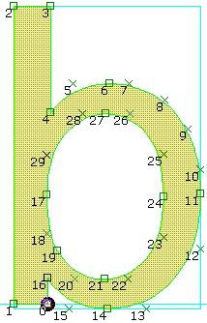
Function Overview
Scaleable Fonts
Truetype uses two main technologies to describe outlines:
Quadratic B-splines (series of Bézier) define the shape
Hinting controls the optimal rasterization (through an interpreted program)
High resource requirements:
CPU should be >> 100 MIPS
Caching needs >> 150 kByte of RAM
Can save much ROM if
many sizes needed
rotated text needed

Slide 12
Function Overview
Transparency /Alpha
Mix transparent bitmap B1 in foreground and background bitmap B2:
B3 = α x B1 + (1.0 - α) x B2; 0.0 <= α <= 1.0 (floating point)
B3 = (α x B1 + (255 - α) x B2) / 255; 0 <= α <= 255 (fixed point)
α gives the amount of transparency:
α= 0 completely transparent (only background)
α= 1.0 (255) non transparent (opaque, only foreground)
Every color RGB has to be mixed separately with α-factor
Important variants:
different α for every pixel: Alpha map
same α for every pixel: Constant Alpha

Slide 13
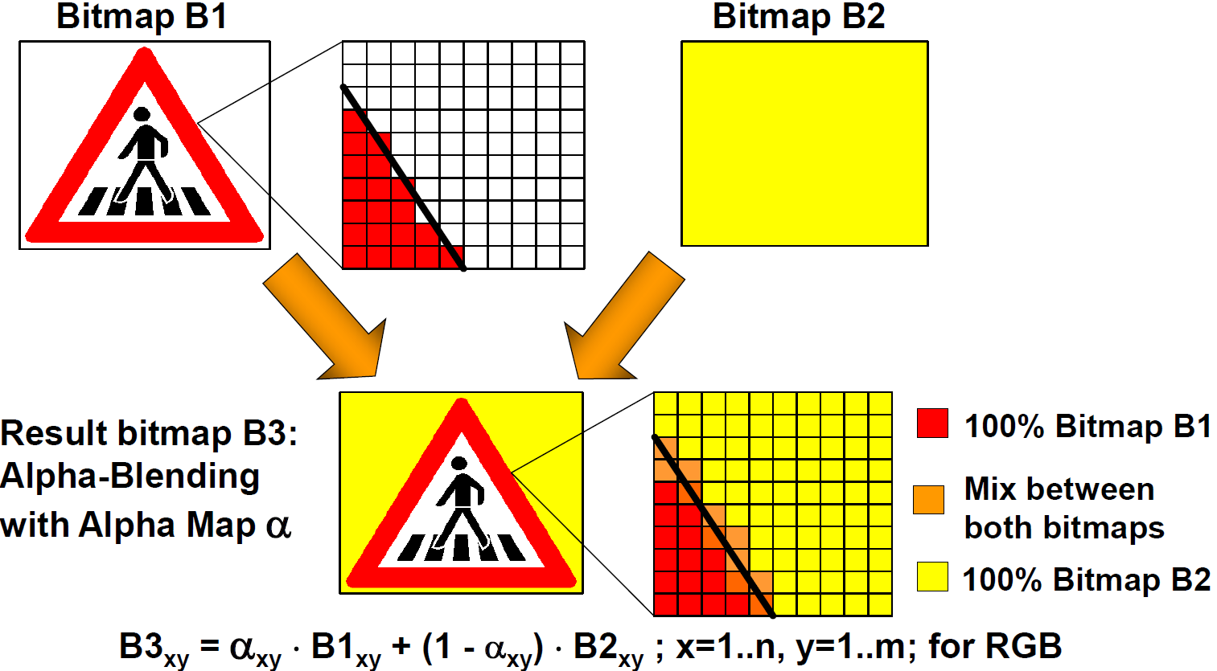
Function Overview
Alpha map for Anti-Aliasing

Slide 14
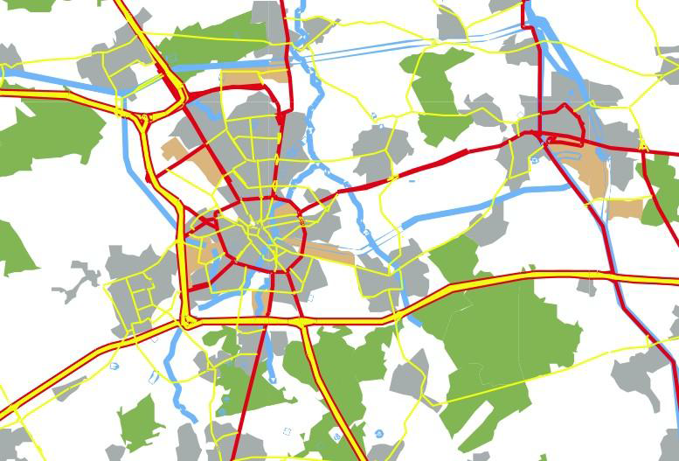
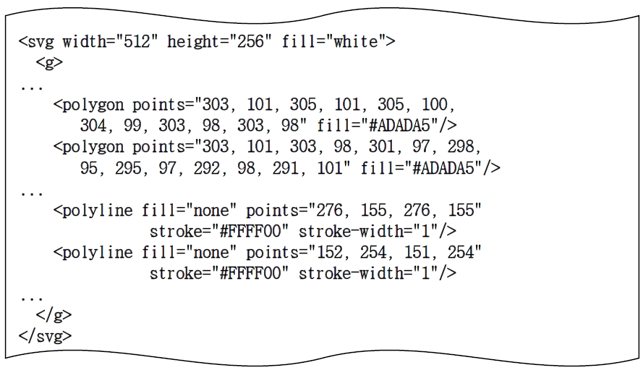
Function Overview
Vector Graphics Support
SVG is an XML based vector format used in internet and UMTS:
High resource requirements; CPU should be >>100 MIPS
Potential to save much bandwidth (use CAN instead of LVDS)
Map of Eindhoven in gPEC demo (107 kB, compressed 12kB)
Scalable Icons (5 kB, compressed 2kB)

Slide 15
Function Overview
2D Graphics Support
Drawing Primitives like
Lines
Dots
Circles
Ellipses
Rectangles
Polygones
Splines

Slide 16
Function Overview
Bitmap/Texture Support
Draw bitmap images
As they are
With Blending
With Scaling / Zooming
With Rotation
With Transparency Masks
With Colorization
As a sequence of images (animation, streaming)
With texture mapping (aka. Meshing)

Slide 17
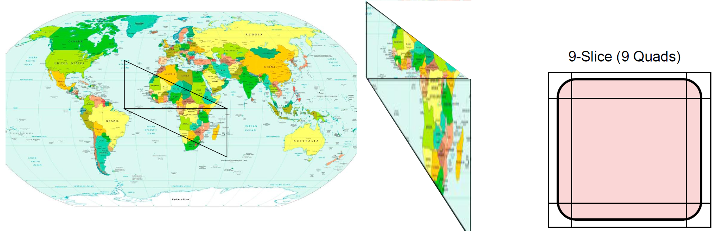
Function Overview
Bitmap/Texture Support
Left example shows a texture mapped onto a triangle strip
Vertices of triangles can be in 3D space (or 2D plane)
Can do scaling, rotation by moving the points
Interpolation / filtering is applied; border between two triangles will be smooth
Also Quad option e.g. for 9-Slice Scaling, edge-antialiasing option

Slide 18
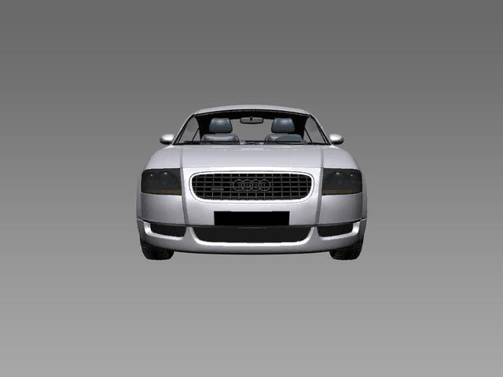
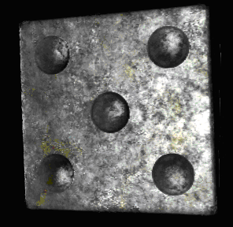
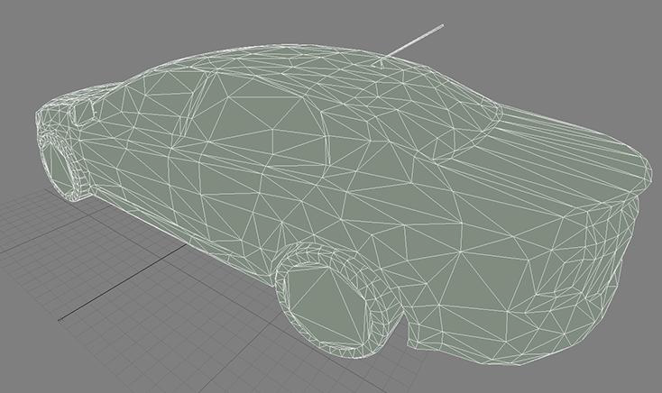
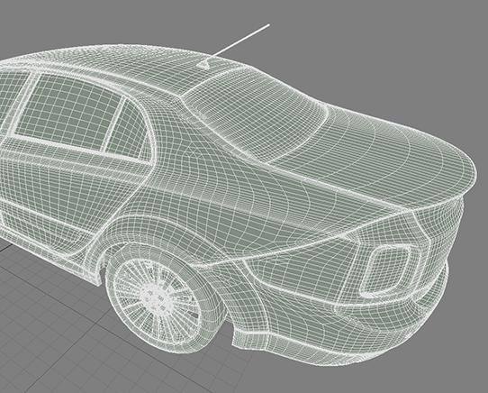
Function Overview
3D Support (EGL, Open GL)
3D Models used for e.g Pointers or more complex geometric figures
Large number of triangles in original model not good for embedded target
Reduced model only preserves “shape”
Lighting is done in much better quality by texturing approach
Details on Open GL language: https://www.opengl.org/

Slide 19
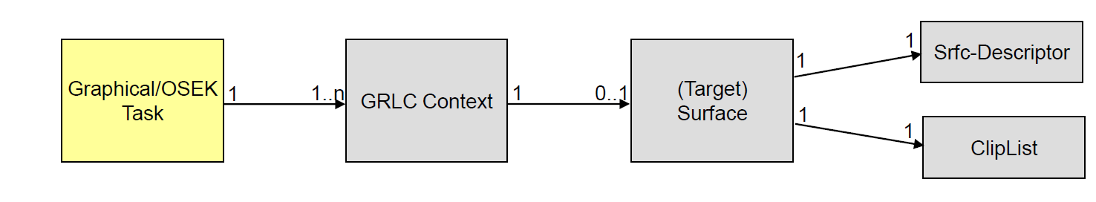
Context
A render context allows to specify the drawing parameters
Clipping area, Positions, Colors, Texture-ID, Font
Specific for the output device (e.g. a display)
Multiple contexts may be used
A context is usually connected to a surface (render target)

Slide 20
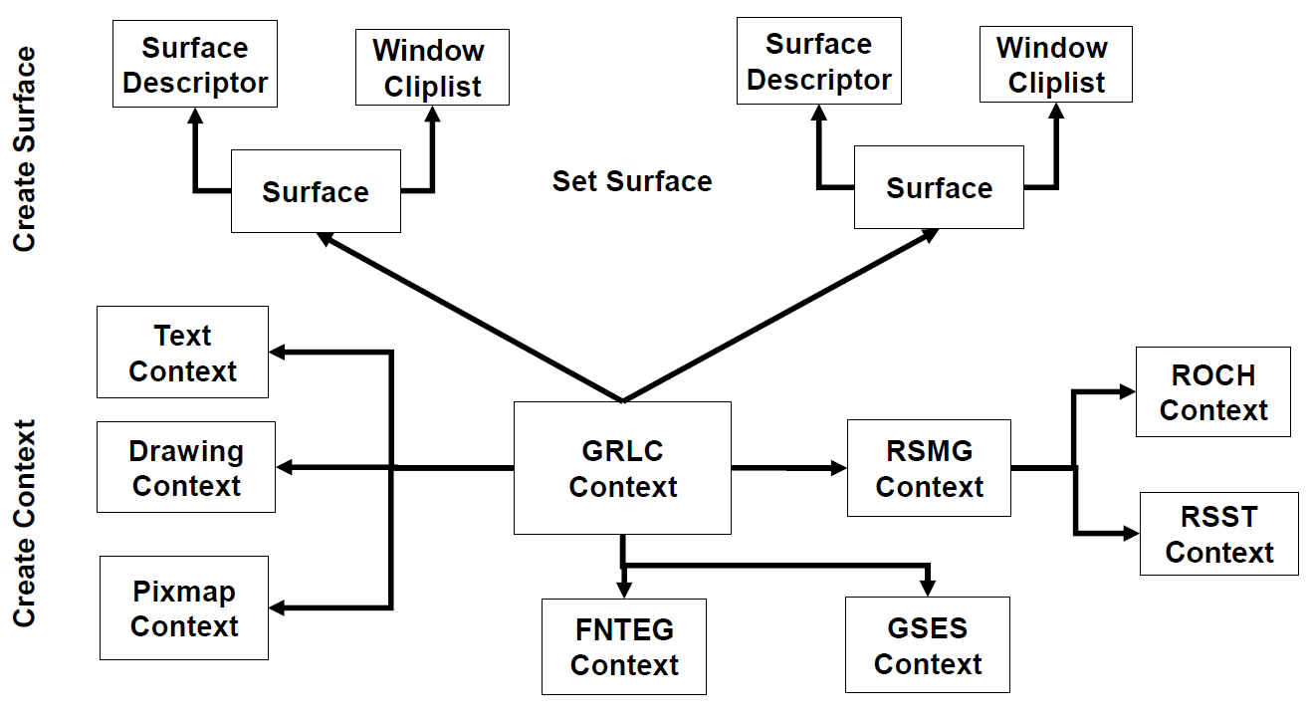
Context

Slide 21
Surface
A surface is an object in the GS representing an area in the RAM which contains pixel data, e.g. Color Format: RGBA8888 (4 Byte per Pixel)
RGBA means one 1 byte value for red, for green for blue and for alpha
Alpha means transparency, 0 = 0 %, full transparent, you can “see” the content underneath 255 = 100 %, full opaque, you can not see what is underneath
7f 7f 7f ff 7f 7f 7f ff 7f 7f 7f ff ... 7f 7f 7f ff
7f 7f 7f ff 7f 7f 7f ff 7f 7f 7f ff ... 7f 7f 7f ff
...
7f 7f 7f ff 7f ff 7f ff 7f 7f 7f ff ... ff 7f 7f ff
7f 7f 7f ff 7f ff 7f ff 7f 7f 7f ff ... ff 7f 7f ff
...
7f 7f 7f ff 7f ff 7f ff ff ff 7f ff ... ff 7f 7f ff
7f 7f 7f ff 7f ff 7f ff ff ff 7f ff ... ff 7f 7f ff
...
7f 7f 7f ff 7f 7f 7f ff ff ff 7f ff ... 7f 7f 7f ff
7f 7f 7f ff 7f 7f 7f ff ff ff 7f ff ... 7f 7f 7f ff
...
7f 7f 7f ff 7f 7f 7f ff 7f 7f 7f ff ... 7f 7f 7f ff
7f 7f 7f ff 7f 7f 7f ff 7f 7f 7f ff ... 7f 7f 7f ff
…
visual representation
numerical representation

Slide 22
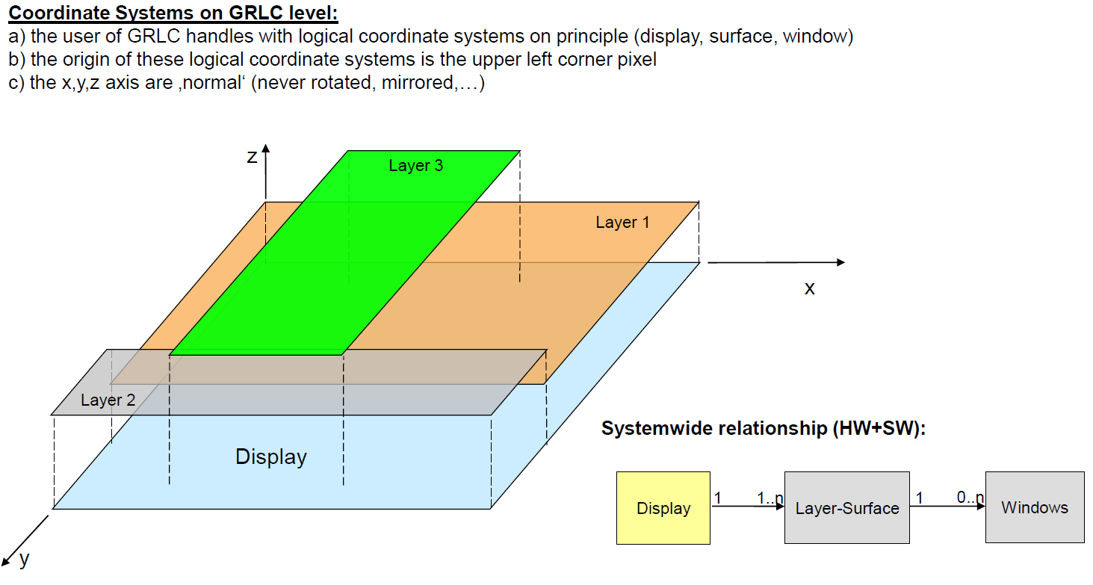
Surface

Slide 23
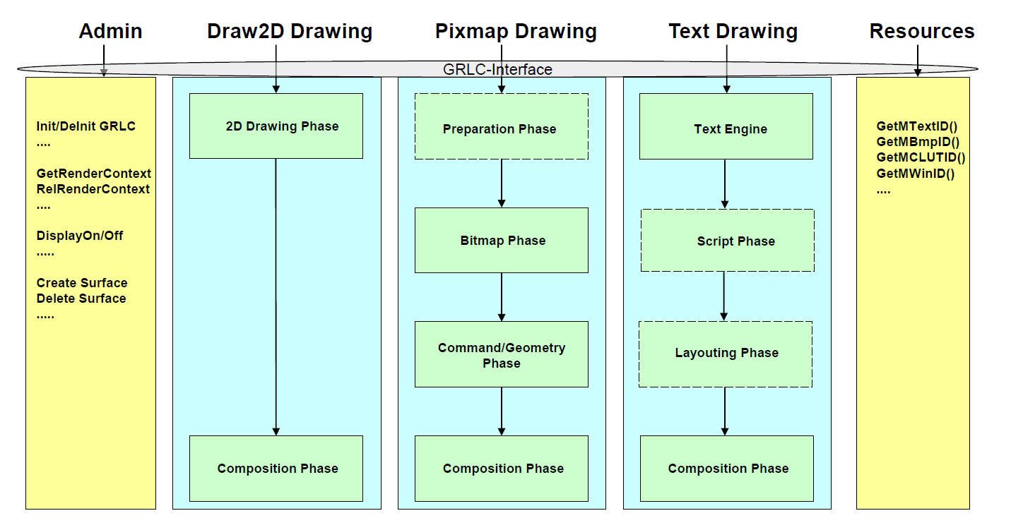
Rendering Model with Pipelines
Pipelining means the serialization of steps/phases to produce the graphic output:

Slide 24
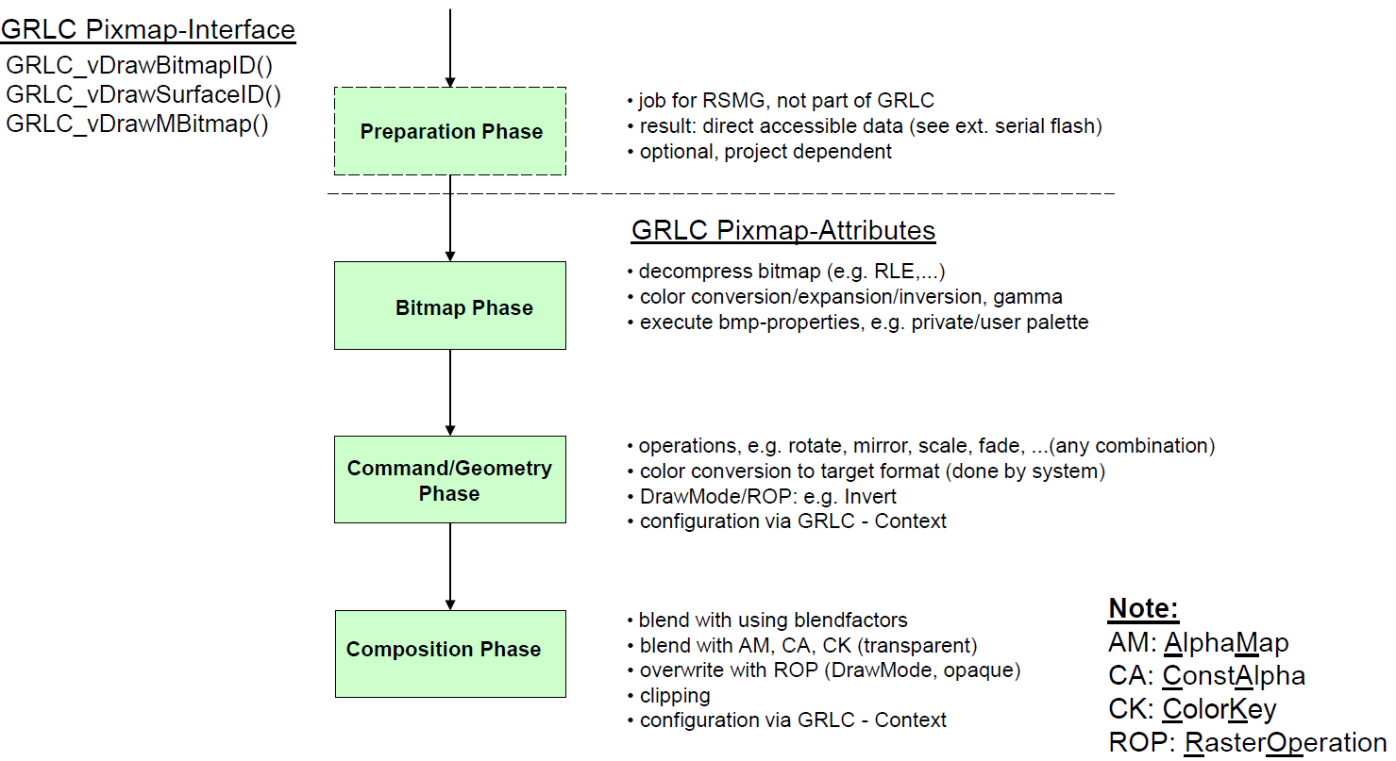
Pixmap Pipeline Model

Slide 25
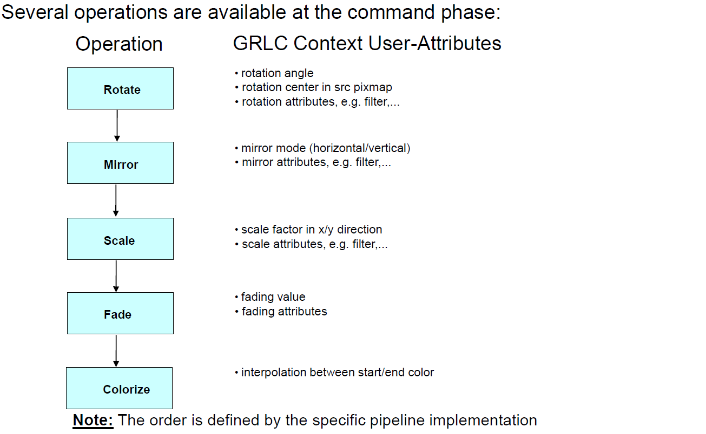
Pixmap Pipeline: Command/Geometry Phase

Slide 26
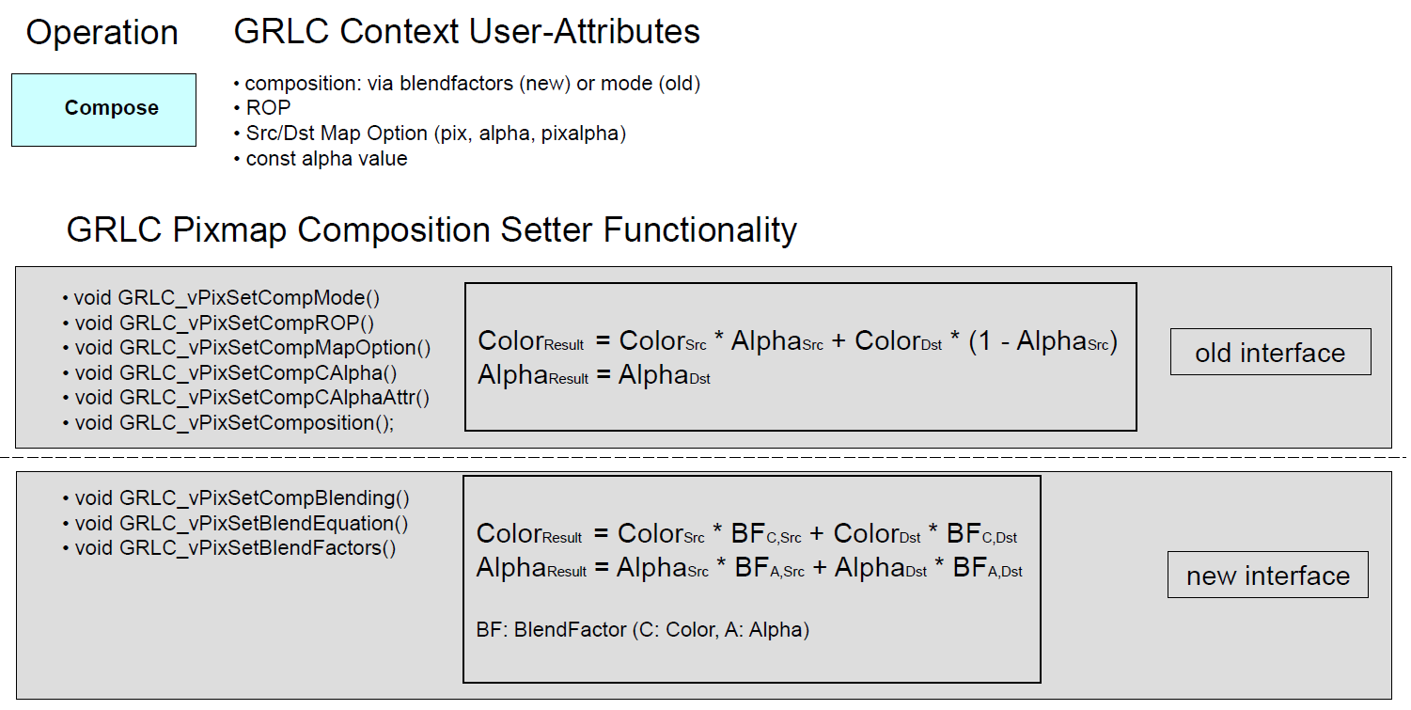
Pixmap Pipeline: Composition Phase

Slide 27
Pixmap Pipeline: Blending Composition
Blending textures with alpha
Resulting Pixels are calculated using the following s.c. Blend Equation
Color_{Result} = Color_{Src} * BF_{C.Src} + Color_{Dst} * BF_{C.Dst}
Alpha_{Result} = Alpha_{Src} * BF_{A.Src} + Alpha_{Dst} * BF_{A.Dst}
BF: BlendFactor (C: Color, A: Alpha)
Blend Factors can be different for each component resulting in various blend equations
Details about Blending can be found here:

Slide 28
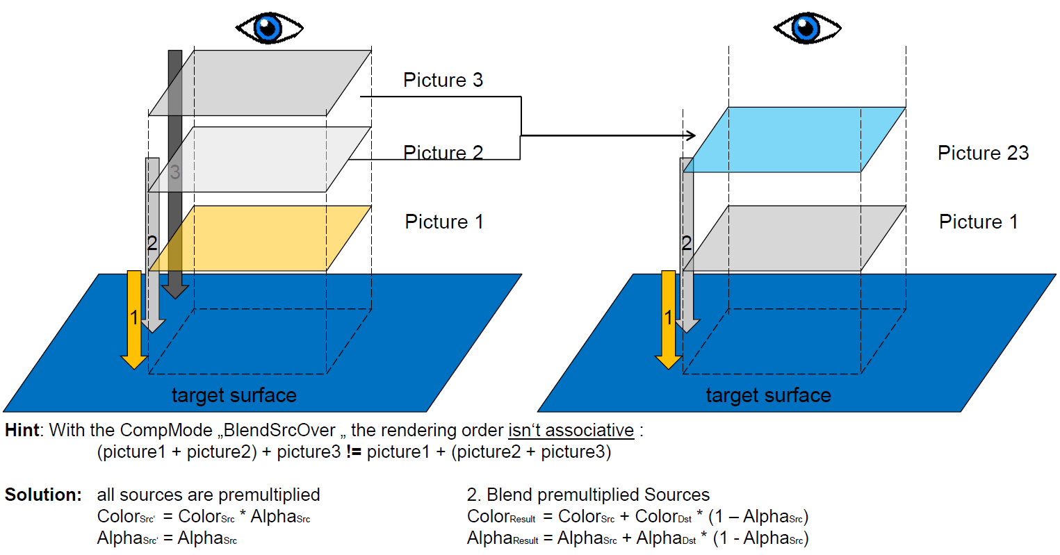
Pixmap Pipeline: Blending Composition

Slide 29
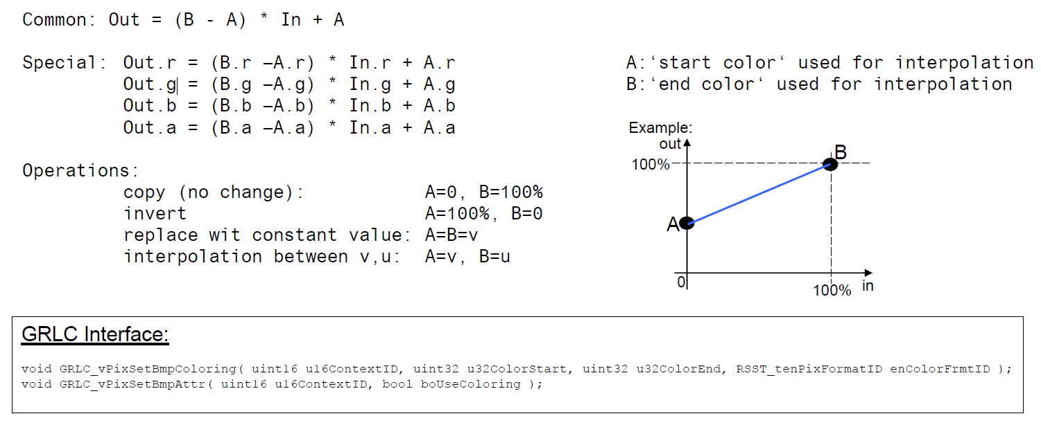
Pixmap Pipeline: Colorization

Slide 30
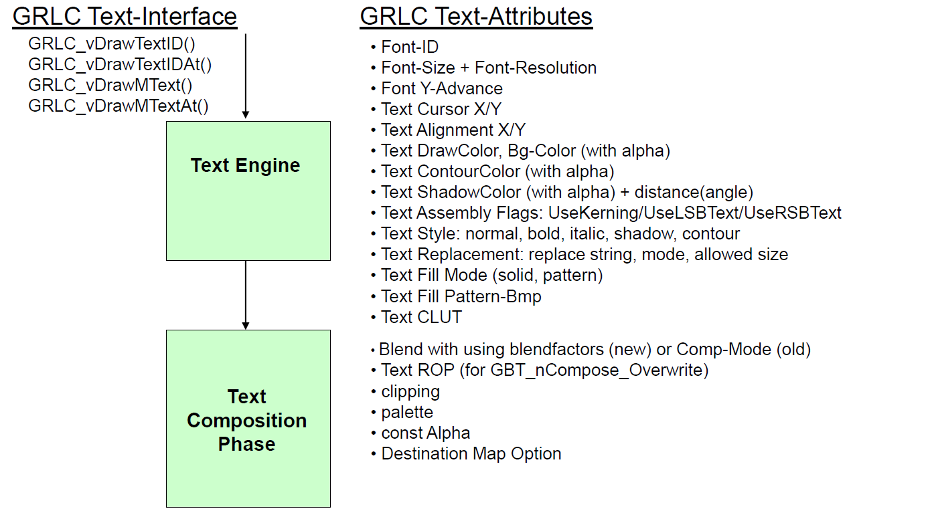
Text Pipeline Model

Slide 31
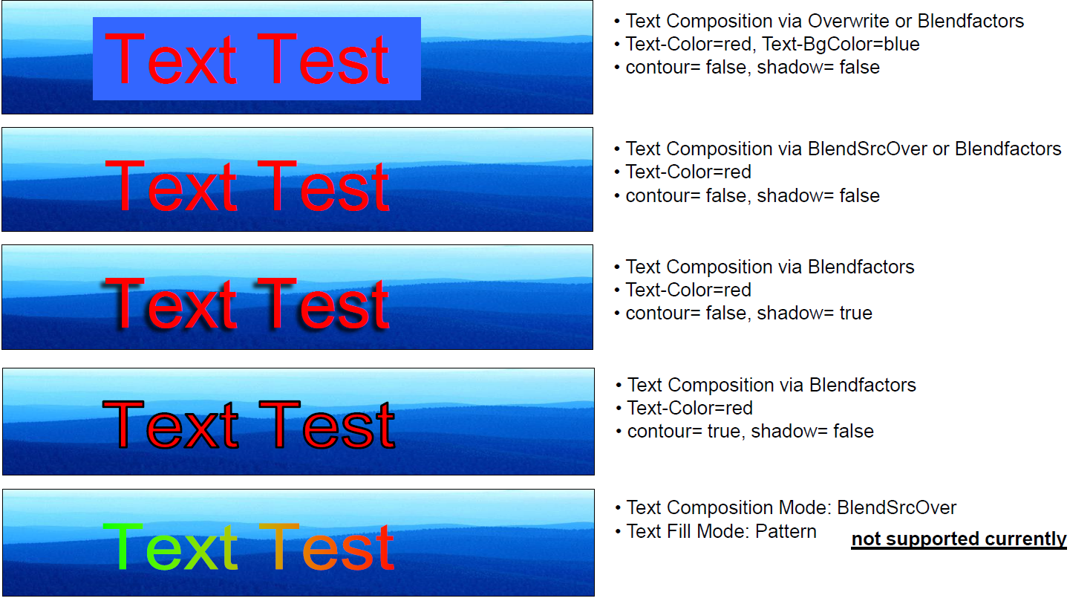
Text Pipeline: Composition Phase

Slide 32
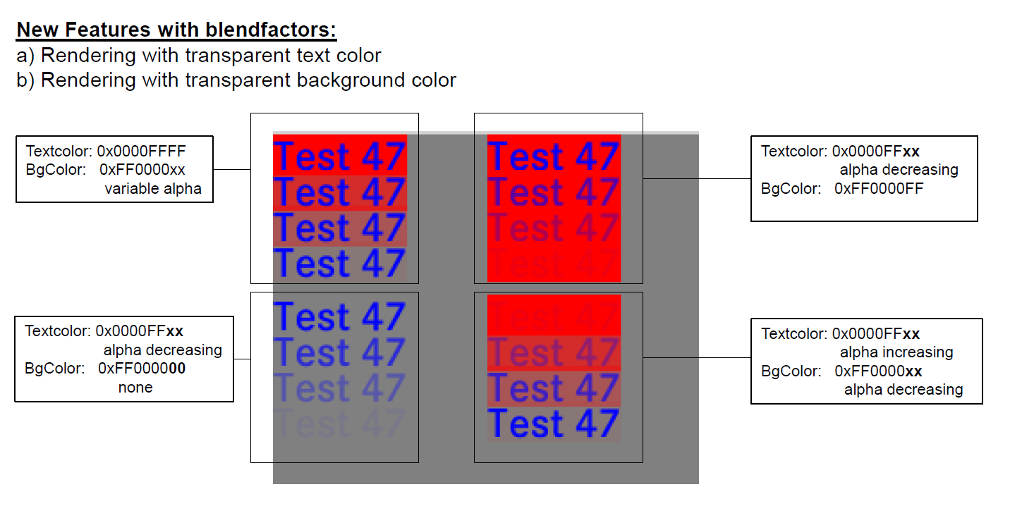
Text Pipeline: Composition Phase

Slide 33
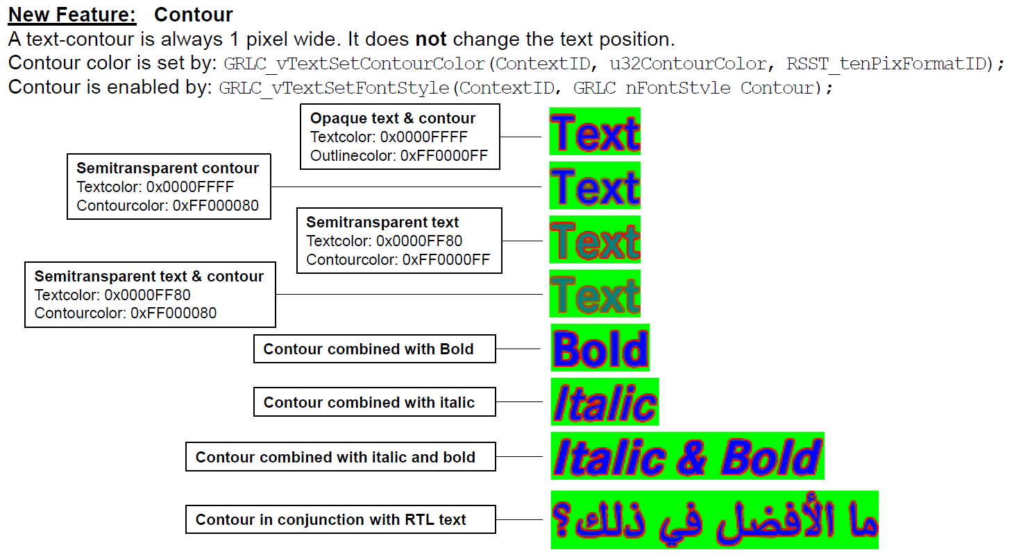
Text Pipeline: Composition Phase

Slide 34
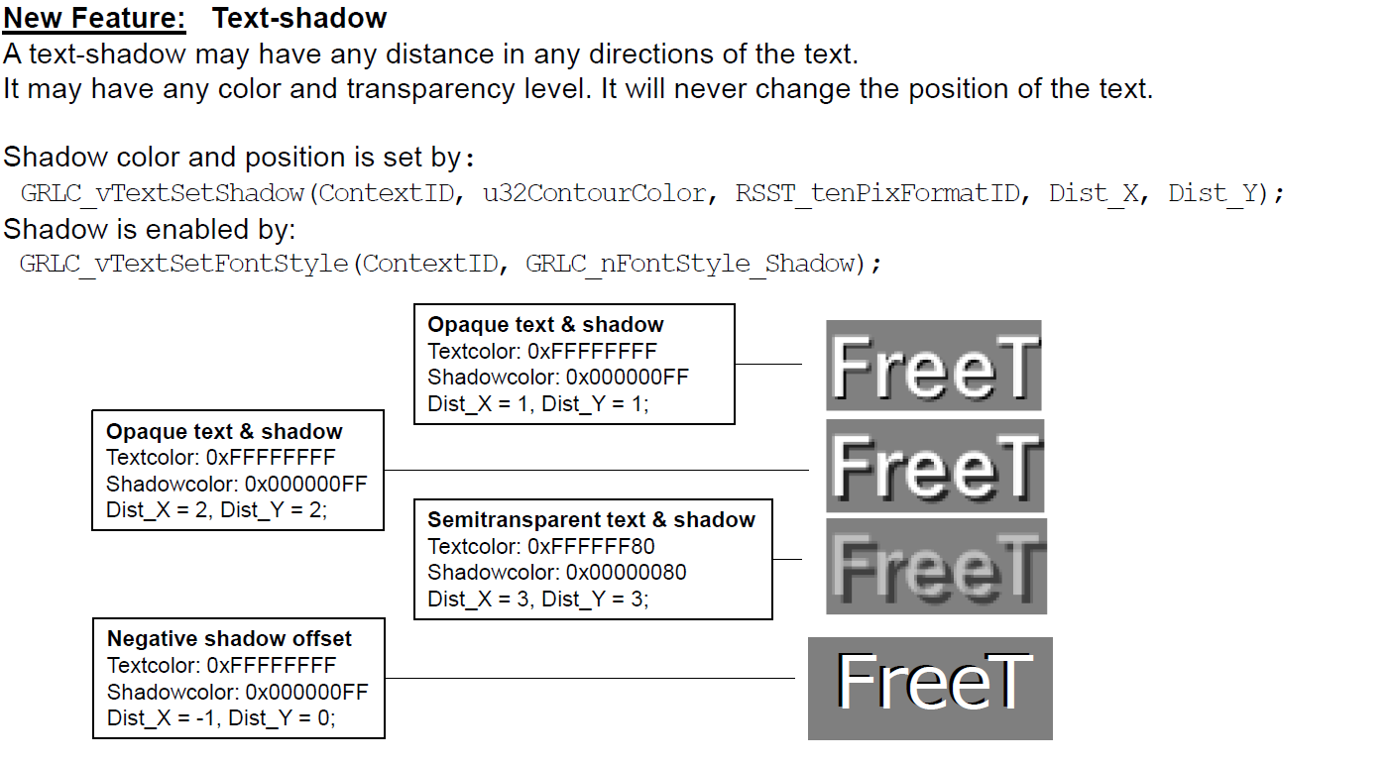
Text Pipeline: Composition Phase

Slide 35
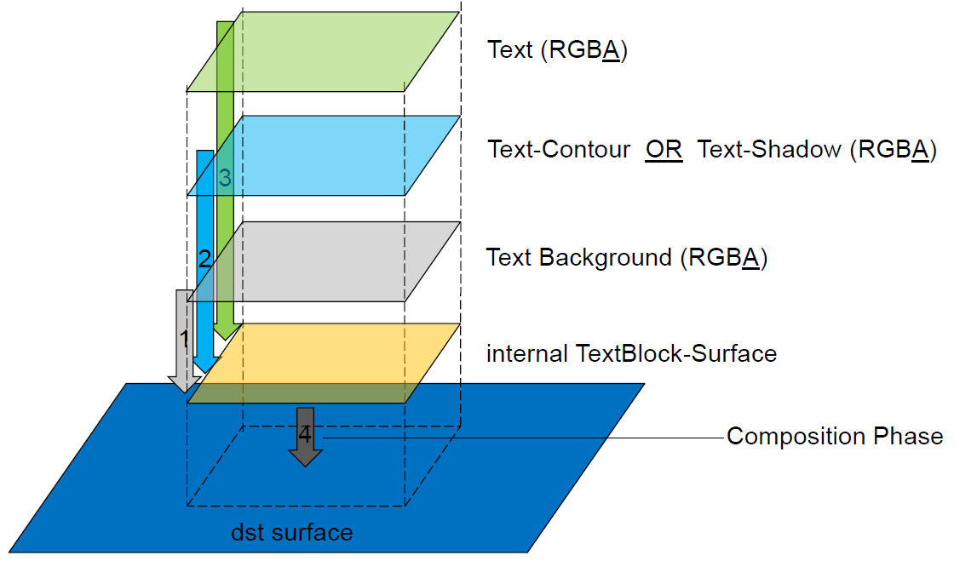
Text Pipeline: Layering

Slide 36
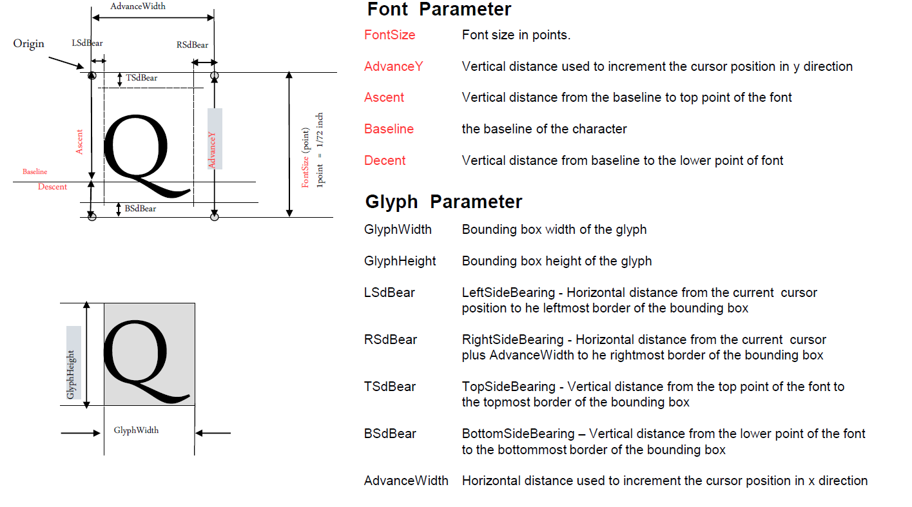
Text Pipeline: Font and Glyph Parameters
More details about Fonts: http://www.freetype.org/freetype2/docs/glyphs/index.html

Slide 37
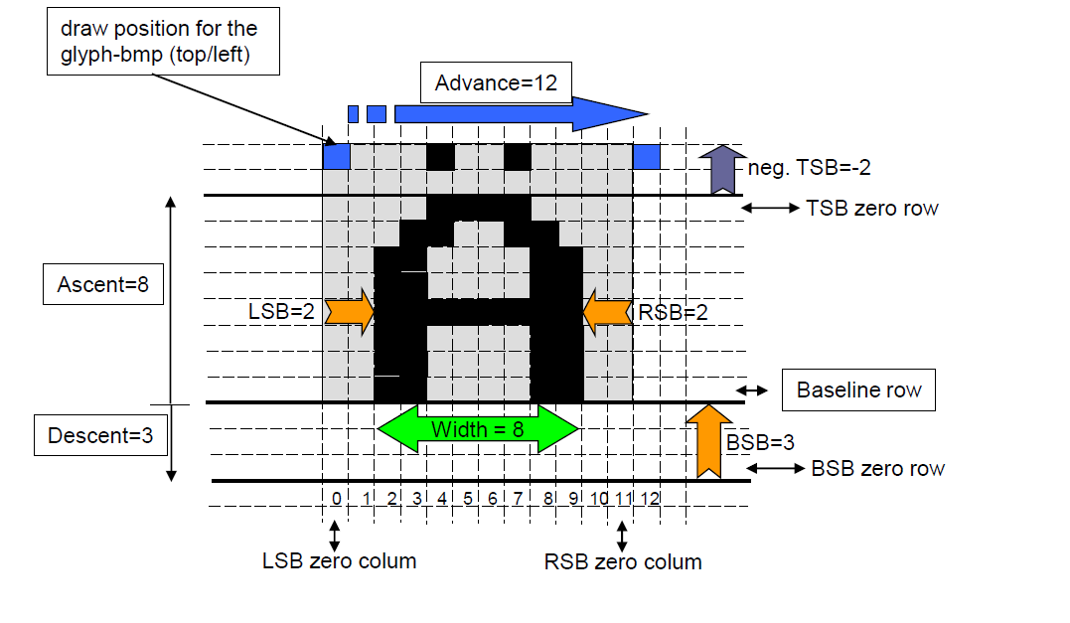
Text Pipeline: Font and Glyph Parameters
TSB: Top Side Bearing
BSB: Bottom Side Bearing
LSB: Left Side Bearing
RSB: Right Side Bearing

Slide 38
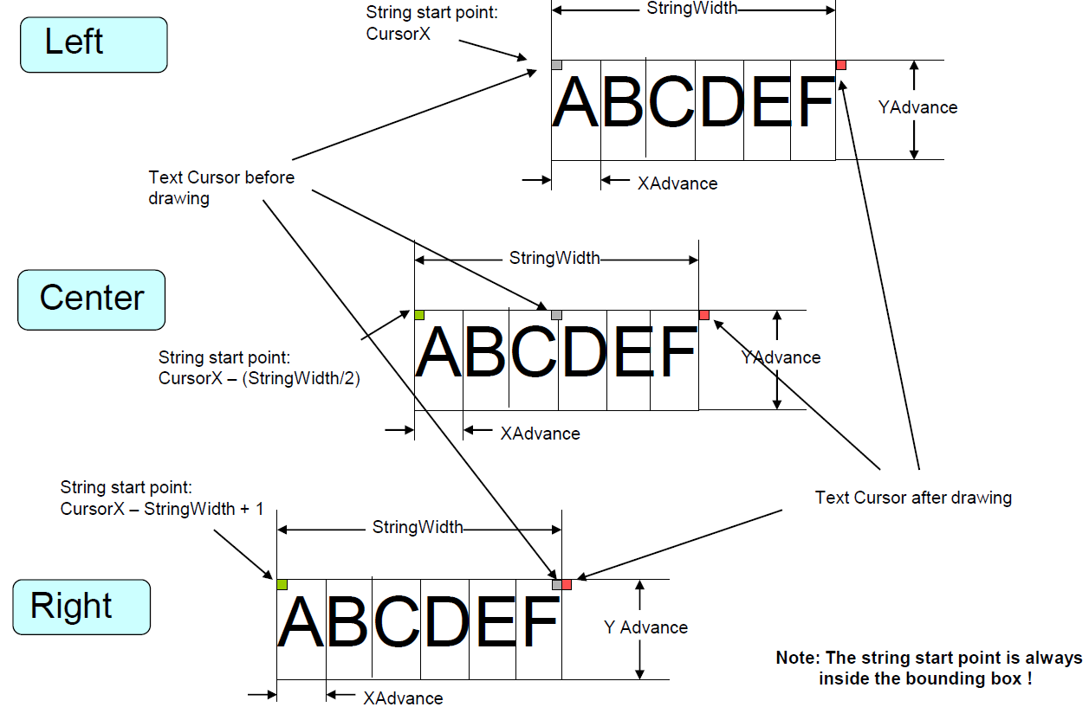
Text Pipeline: Alignment

Slide 39
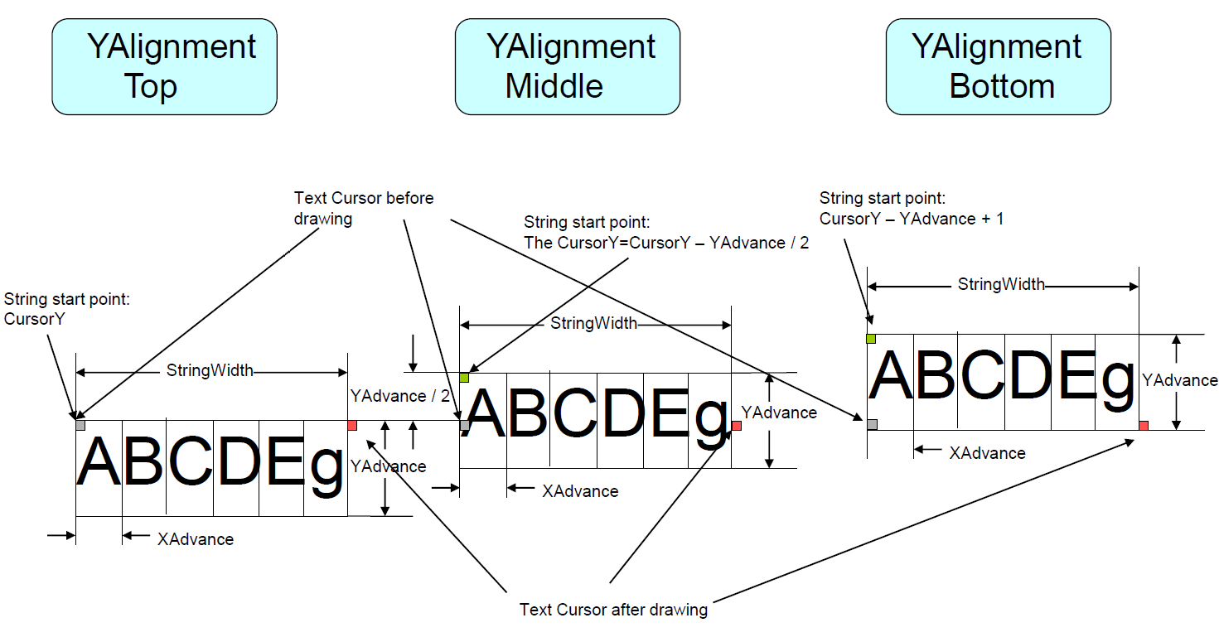
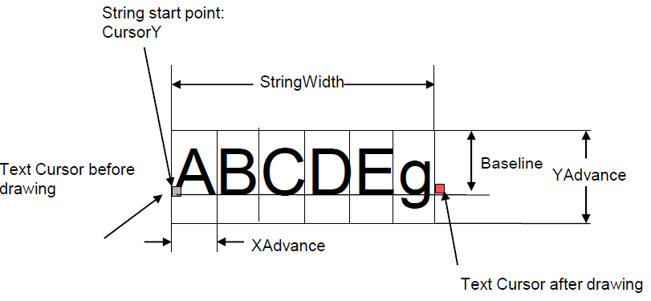
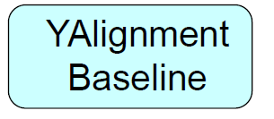
Text Pipeline: Alignment

Slide 40
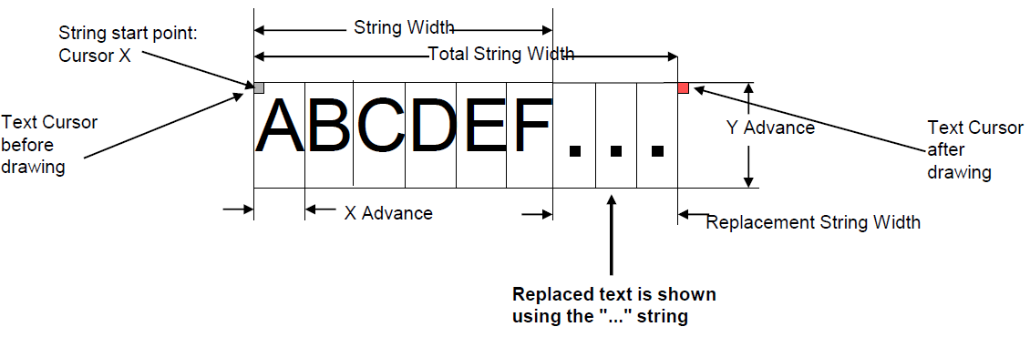
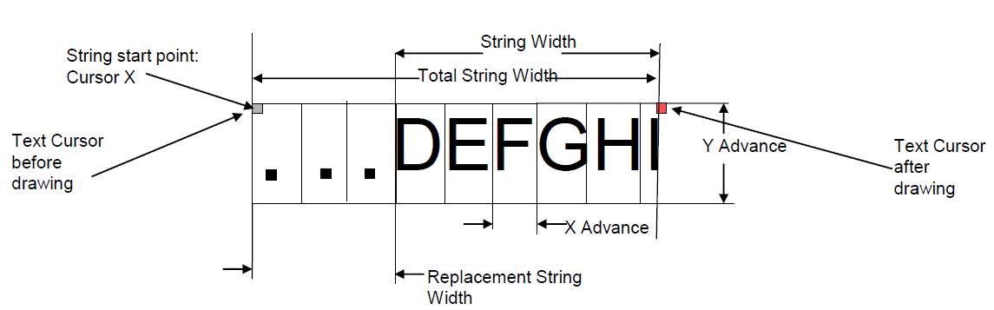
Text Pipeline: Truncation
Used to display text within a limited space
• Text needs to be "cut" if its string length does not fit within the limited space

Slide 41
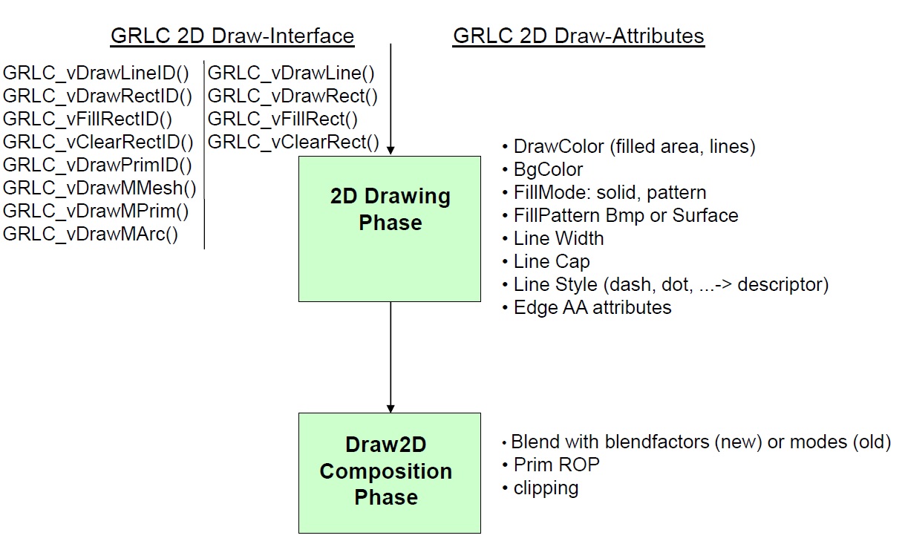
2D Drawing Pipeline Model

Slide 42
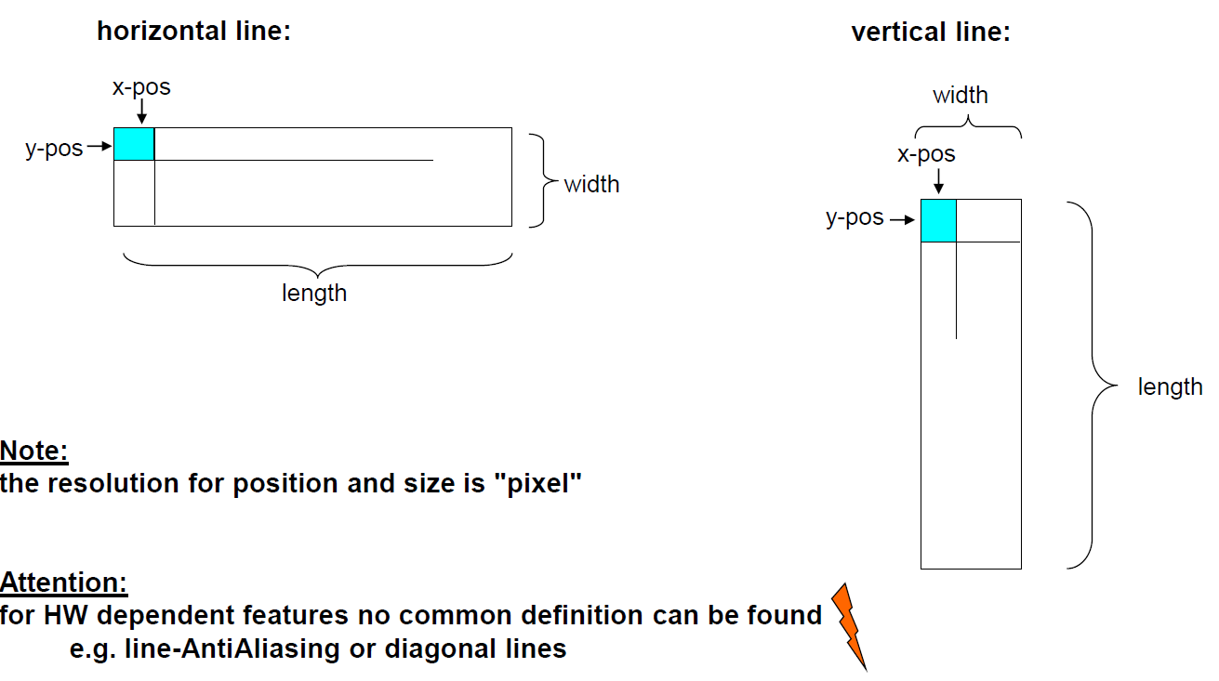
2D Pipeline: Drawing Phase

Slide 43
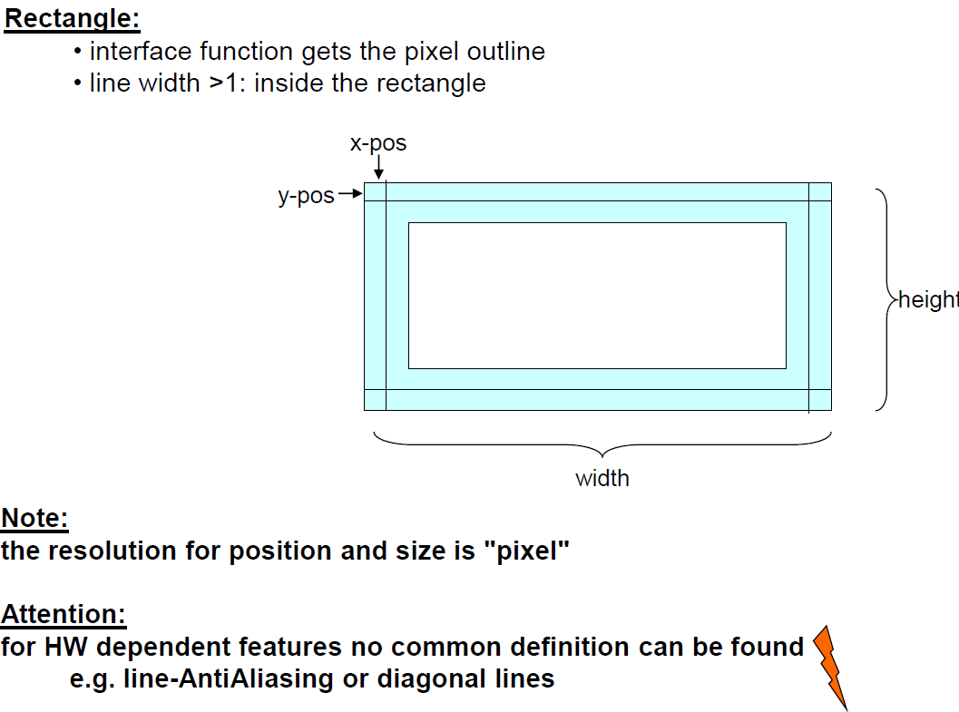
2D Pipeline: Drawing Phase

Slide 44
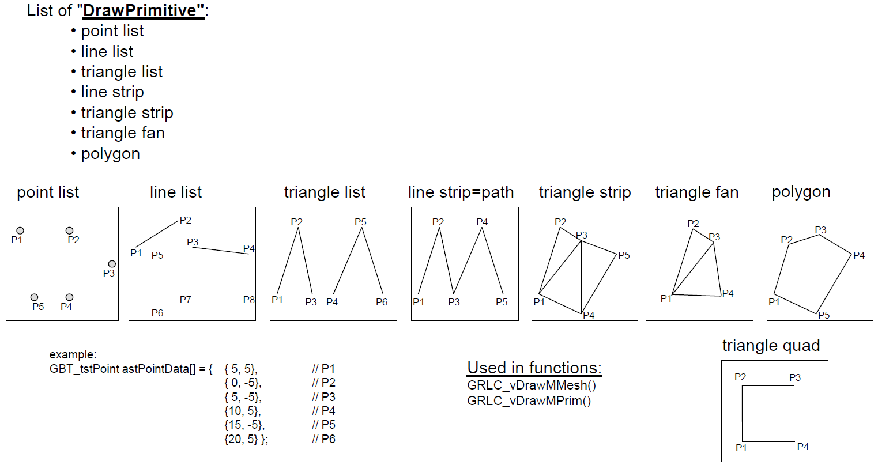
2D Pipeline: Drawing Phase

Slide 45
Resource Management: Types
Resource Types
Bitmap
Text
File
CLUT
Line
Rectangle
Window
Sound

Slide 46
Resource Management: Interfaces
The class GRLC_GResObj supports the Get/Release functionality for: bitmap, text, file, CLUT, line, rectangle, window and Display Objects
Note:
• the application gets a pointer to a "Managed Object"
• the application is responsible for the lifetime of the object
• Interfaces:
GBT_tstMText* GRLC_pstGetMTextID(); void GRLC_vReleaseMText();
GBT_tstMBmp* GRLC_pstGetMBitmapID(); void GRLC_vReleaseMBitmap();
GBT_tstMPal* GRLC_pstGetMCLUTID(); void GRLC_vReleaseMCLUT();
GBT_tstMRect* GRLC_pstGetMRectID(); void GRLC_vReleaseMRect();
GBT_tstMLine* GRLC_pstGetMLineID(); void GRLC_vReleaseMLine();
GBT_tstMFile* GRLC_pstGetMFileID(); void GRLC_vReleaseMFile();
A "Managed Object" contains information about:
• memory location of the object's control structure and the object's data
• the RSST ID of the object
• cache policy used for this object
• access rights (read/write) of control and data

Slide 47
Resource Management: ID and Group
Each GS resource has a unique ID to be used with the GRLC functions
Resource objects can be organized in groups (of the same type)
Groups are used for resource booting
Groups are used to form functional units
The group information is coded within the resource ID (RSST ID)
Resources are managed by the packages RSST, RSMG and RSDM
RSST: storage of the resource objects and their properties
RSMG: Interface to access the resources
RSDM: Manages dependencies of resources, see next slide
Resources are configured using an XML file (RSST_ExportData.xml)
A special tool (RSST-Export) is used to convert object parameters and data into code or binary (linkeable) parts of the GS configuration
The objects are compiled and linked to the configured memory location (RAM, Flash) to be accessed at runtime.

Slide 48
Resource Management: Dependencies
Dependencies are used to handle variants of graphical objects
Dependencies are set from outside using GRLC_vSetDependency interface
Dependencies types and values (codes) must be preconfigured in the GS configuration XML
Graphical objects can be linked to dependencies / dependency codes
When the object is accessed the matching variant of the current dependency value is selected automatically by the RSMG/RSDM when accessing the resource.

Slide 49
GRLC Interface
A description of the most common GRLC interfaces and drawing functions can be found here for self-study

Slide 50
Thank You!
Schleißheimer GmbH
Am Kalkofen 10 D-61206 Wöllstadt Tel.: +49 6034 9148-701 Fax: +49 6034 9148-91 vertrieb@schleissheimer.de
www.schleissheimer.de

